Slide 1
jQuery: Getting Started
Introduction

Slide 2

Demo
Course Preview

Slide 3
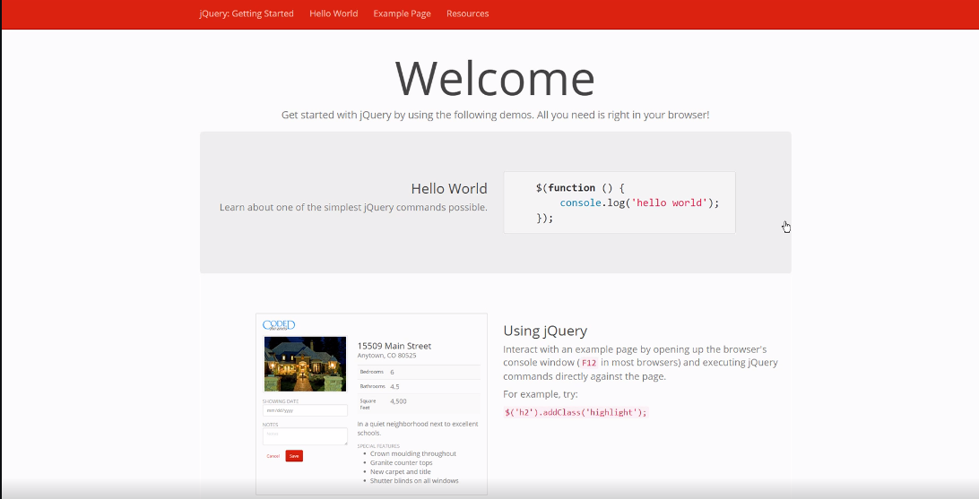

Slide 4
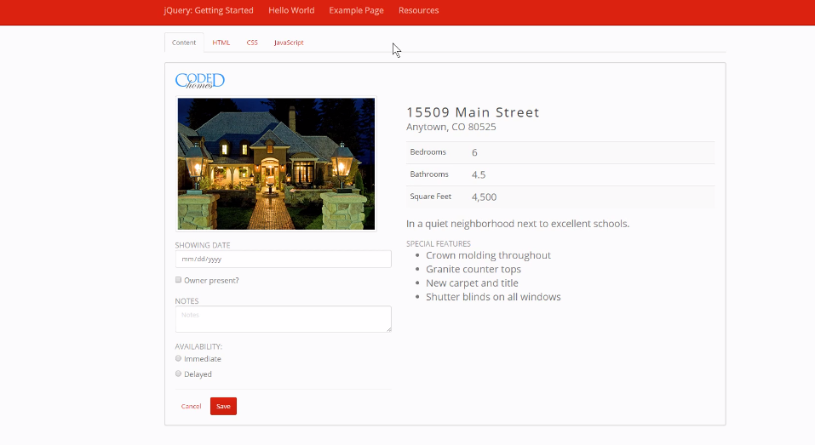

Slide 5
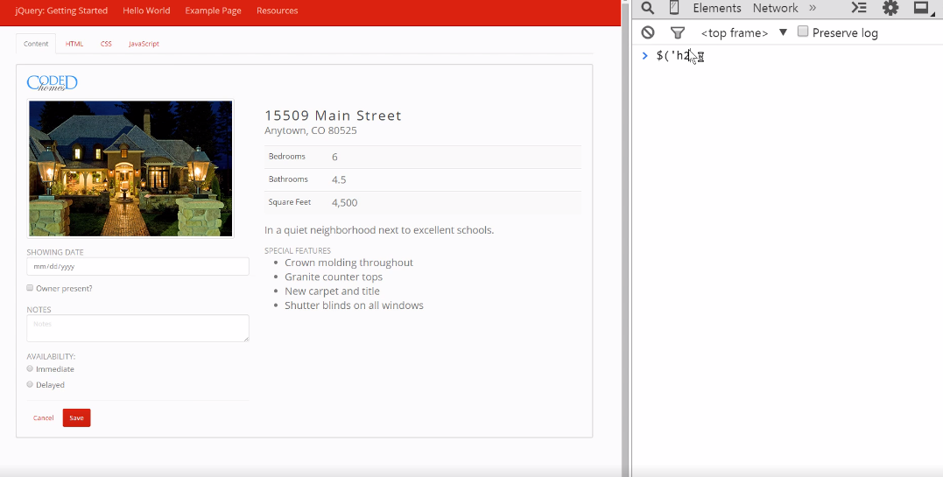

Slide 6
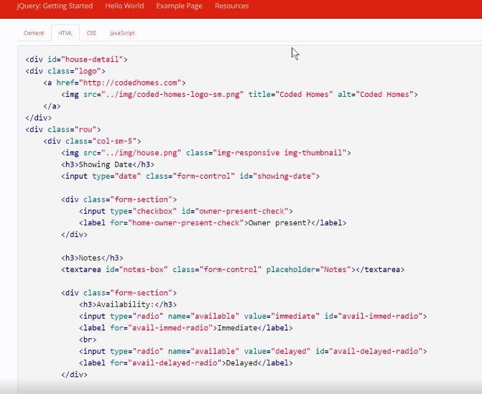

Slide 7
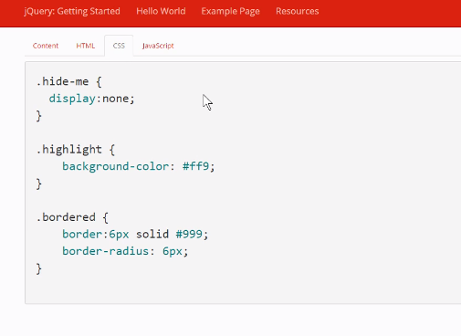

Slide 8
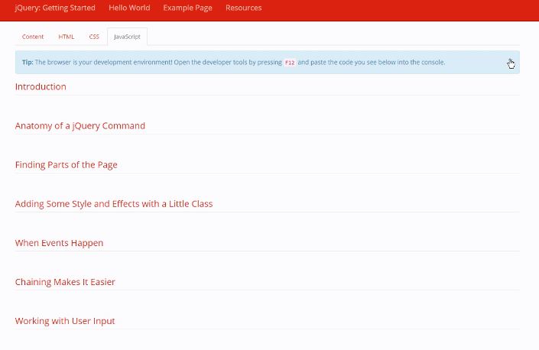

Slide 9
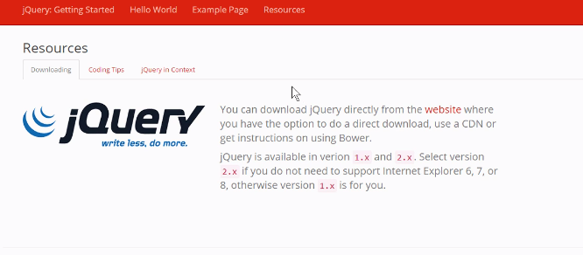

Slide 10
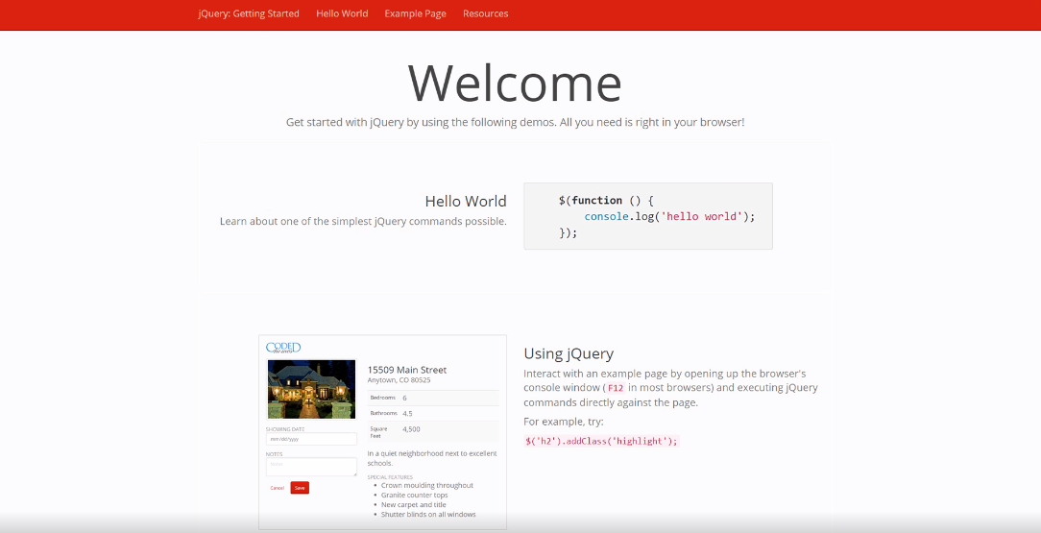

Slide 11
Demo
Raw DOM: add/remove class

Slide 12
Demo
jQuery: add/remove class

Slide 13

jQuery is more than just an API

Slide 14
jQuery Browser Bug Workarounds
http://bitly.com/jquery-workarounds

Slide 15
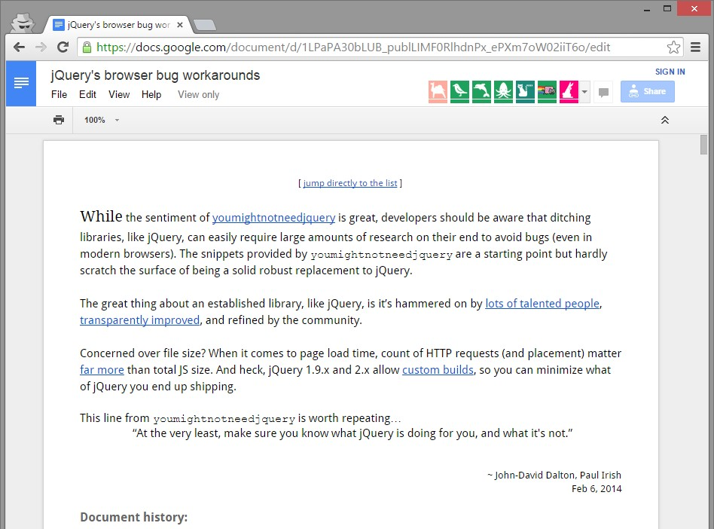

Slide 16


Slide 17
Summary

Slide 18

Benefits of jQuery

Slide 19
Samples

Slide 20

Anatomy of a jQuery Command

